Slide 1
Dats 6104-Individual project
Erin Kreiling
Spring 2019

Slide 2
Agenda
About the Data
The Website
Introductory Plots
Comparing GDP and Spending
Healthcare, Education, and Military
Overall Analysis

Slide 3
About the data
All collected from the World Bank
2008-2015 data for all G20 countries
Variables:
Country Name
Population
GDP
Education Expenditure
Military Expenditure
Healthcare Expenditure

Slide 4
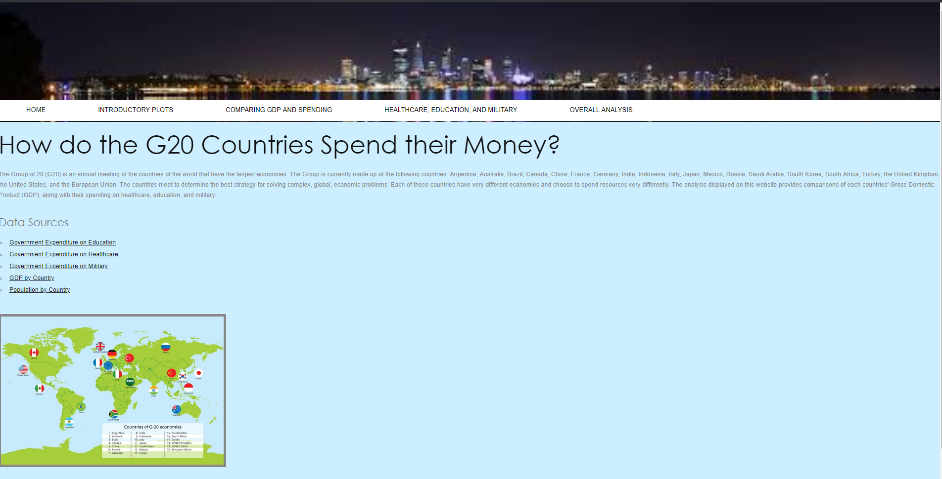
The website

Slide 5
Introductory plots

Slide 6
How much money does each G20 country spend on military, healthcare, and education?
Most countries spent similar amounts on healthcare, military, and education.
The European Union and the USA spent significantly more than any other country.
China has been gradually increasing their spending in military over the years, whereas most of the other countries relatively stable.
For Healthcare, there appear to be 3 main spending groups:
1. EU and USA
2. France, Germany, Japan, and UK
3. Everyone else
The previous theme seems to repeat for education, although Brazil would join the second group

Slide 7
Comparing gdp and spending

Slide 8
How much money does each G20 country spend on military, healthcare, and education, as compared to their overall Gross Domestic Product (GDP)?
Again, the EU and the USA have the highest spending, as compared to their GDP
China did not report education expenditure
Most countries spent more on education and healthcare than military (as a portion of their GDP)

Slide 9
Per person expenditure by country
The USA spends nearly double the amount per person on healthcare, as compared to military and education, as do Japan, Germany, and Canada.
India and Indonesia have extremely low expenditure in all 3 areas, compared to the other countries
Australia spends nearly the exact same amount per person on healthcare and education.
Saudi Arabia spends nearly double the amount per person on military, as compared to healthcare and education.

Slide 10
Healthcare, education, and Military

Slide 11
Healthcare vs military vs education
When considering the expenditure as a total (vs per capita), we see pretty similar behavior.
However, there is a larger group of countries with very low, relative expenditures: Russia, Saudi Arabia, India, Turkey, Mexico, Indonesia, Argentina, and South Africa.

Slide 12
spending over time
Military
Saudi Arabia appears to have increased their spending the most dramatically
The USA spent the most overall in 2015
Healthcare
China appears to have increased their spending most dramatically
The USA spent the most overall in 2015
Education
Note: some missing data
South Korea appears to have increased their spending most dramatically
The EU spends the most overall in 2015

Slide 13
Other overall analysis
Understanding what type of government each G20 country has would be helpful for understanding spending habits
Spending varies across the different areas of the world
It would be interesting to break out education spending by primary vs secondary
While the European Union itself is a member of the G20, it could help the analysis to break out the EU by individual countries
There is obviously a strong relationship between the wealth of the country and its spending habits
In future analysis, I’d like to expand the range of years to consider how spending habits have changed over time

